Slide 2
Race and American Education, Part I

Slide 3
OUTLINE
Does doing well in school affect how your life turns out?
Does doing well in school depend on sex, race, and/or SES?
Do educational opportunities depend on sex, race, and SES?

Slide 4
OUTLINE
Does doing well in school affect how your life turns out?
Does doing well in school depend on sex, race, and/or SES?
Do educational opportunities depend on sex, race, and SES?

Slide 5
Source: 2016 March Current Population Survey

Slide 6
Source: 2016 March Current Population Survey

Slide 7
Source: 2016 American Community Survey

Slide 8
Source: 2014 General Social Survey

Slide 9
Source: 2014 General Social Survey

Slide 10
Source: 2014 General Social Survey

Slide 11
Source: 2012 General Social Survey

Slide 12
Source: 2012 General Social Survey

Slide 13
Source: 2016 National Health Interview Survey

Slide 14
Source: 2016 National Health Interview Survey

Slide 15
Source: 2016 National Health Interview Survey

Slide 16
Source: 2016 March Current Population Survey

Slide 17
Source: High School & Beyond

Slide 18
Source: High School & Beyond

Slide 19
Source: High School & Beyond

Slide 20
Source: High School & Beyond

Slide 21
SUMMARY
In every measurable way, life is much worse if you don’t finish high school and much better if you get a college degree

Slide 22
DISCUSSION
Is it OK that life outcomes depend on education … as long as everyone has an equal chance to get an education?

Slide 23
OUTLINE
Does doing well in school affect how your life turns out?
Does doing well in school depend on sex, race, and/or SES?
Do educational opportunities depend on sex, race, and SES?

Slide 24
Source: National Center for Education Statistics. 2014. Digest of Education Statistics: 2014. Washington, DC: US Department of Education. (Table 220.40)

Slide 25
Source: National Center for Education Statistics. 2014. Digest of Education Statistics: 2014. Washington, DC: US Department of Education. (Table 220.40)

Slide 26
Source: National Center for Education Statistics. 2014. Digest of Education Statistics: 2014. Washington, DC: US Department of Education. (Table 221.10)

Slide 27
Source: National Center for Education Statistics. 2014. Digest of Education Statistics: 2014. Washington, DC: US Department of Education. (Table 222.10)

Slide 28
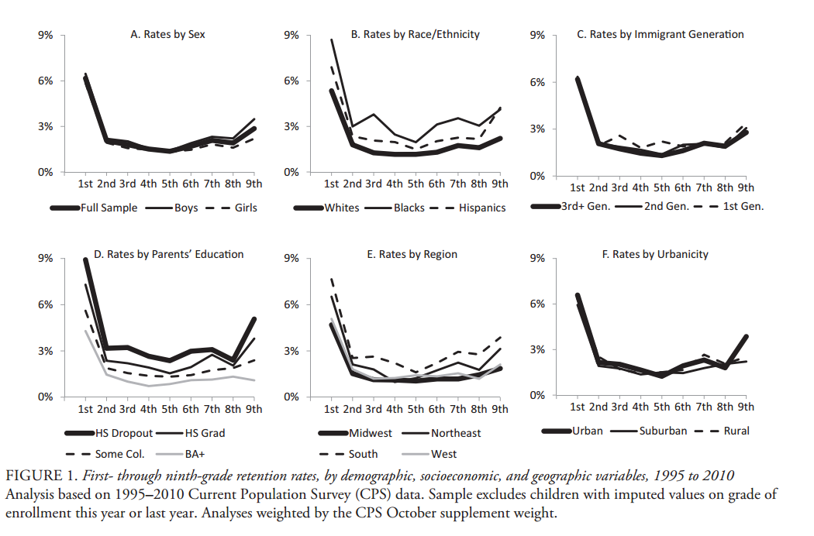
Source: Warren, John Robert, Emily Hoffman, and Megan Andrew. "Patterns and trends in grade retention rates in the United States, 1995–2010." Educational Researcher 43.9 (2014): 433-443.

Slide 29
Source: National Center for Education Statistics. 2014. Digest of Education Statistics: 2014. Washington, DC: US Department of Education. (Table 104.85 and 104.88)

Slide 30
Source: National Center for Education Statistics. 2014. Digest of Education Statistics: 2014. Washington, DC: US Department of Education. (Table 233.40)

Slide 31
Source: National Center for Education Statistics. 2014. Digest of Education Statistics: 2014. Washington, DC: US Department of Education. (Table 233.40)

Slide 32
Source: 2014 American Community Surveys (people age 25+ who completed high school)

Slide 33
Source: U.S. Department of Education, National Center for Education Statistics, 2008 Integrated Postsecondary Education Data System (IPEDS), Spring 2009.

Slide 34
Source: National Center for Education Statistics. 2014. Digest of Education Statistics: 2014. Washington, DC: US Department of Education. (Table 104.85 and 104.88)

Slide 35
SUMMARY
On almost every measurable outcome, racial/ethnic minority and disadvantaged students do worse in school.

Slide 36
DISCUSSION
Are sex, race, and SES differences in educational outcomes OK if everyone has an equal chance to succeed?

Slide 37
OUTLINE
Does doing well in school affect how your life turns out?
Does doing well in school depend on sex, race, and/or SES?
Do educational opportunities depend on sex, race, and SES?

Slide 38
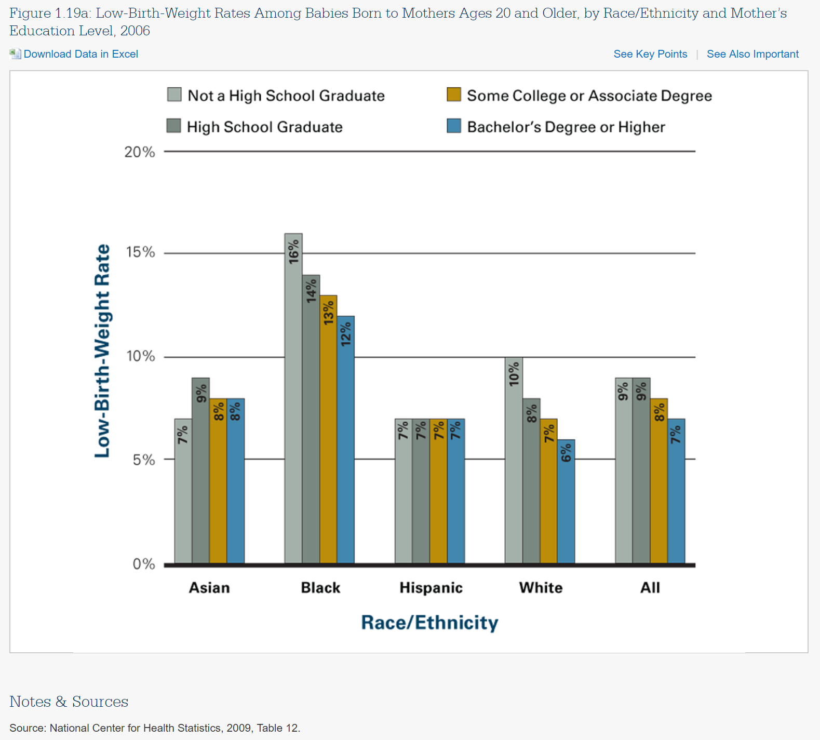

Slide 39
SOURCE: U.S. Department of Education, National Center for Education Statistics, Early Childhood Longitudinal Study, Birth Cohort (ECLS-B), Longitudinal 9-Month–Kindergarten 2007 Restricted-Use Data File.

Slide 40
SOURCE: U.S. Department of Education, National Center for Education Statistics, Early Childhood Longitudinal Study, Birth Cohort (ECLS-B), Longitudinal 9-Month–Kindergarten 2007 Restricted-Use Data File.

Slide 41
SOURCE: U.S. Department of Education, National Center for Education Statistics, Early Childhood Longitudinal Study, Birth Cohort (ECLS-B), Longitudinal 9-Month–Kindergarten 2007 Restricted-Use Data File.

Slide 42
Source: National Center for Education Statistics. 2014. Digest of Education Statistics: 2014. Washington, DC: US Department of Education. (Table 202.50)

Slide 43
Source: National Center for Education Statistics. 2014. Digest of Education Statistics: 2014. Washington, DC: US Department of Education. (Table 202.60)

Slide 44
Source: National Center for Education Statistics. 2016. The Condition of Education: 2016. Washington, DC: US Department of Education. (Page 118)

Slide 45
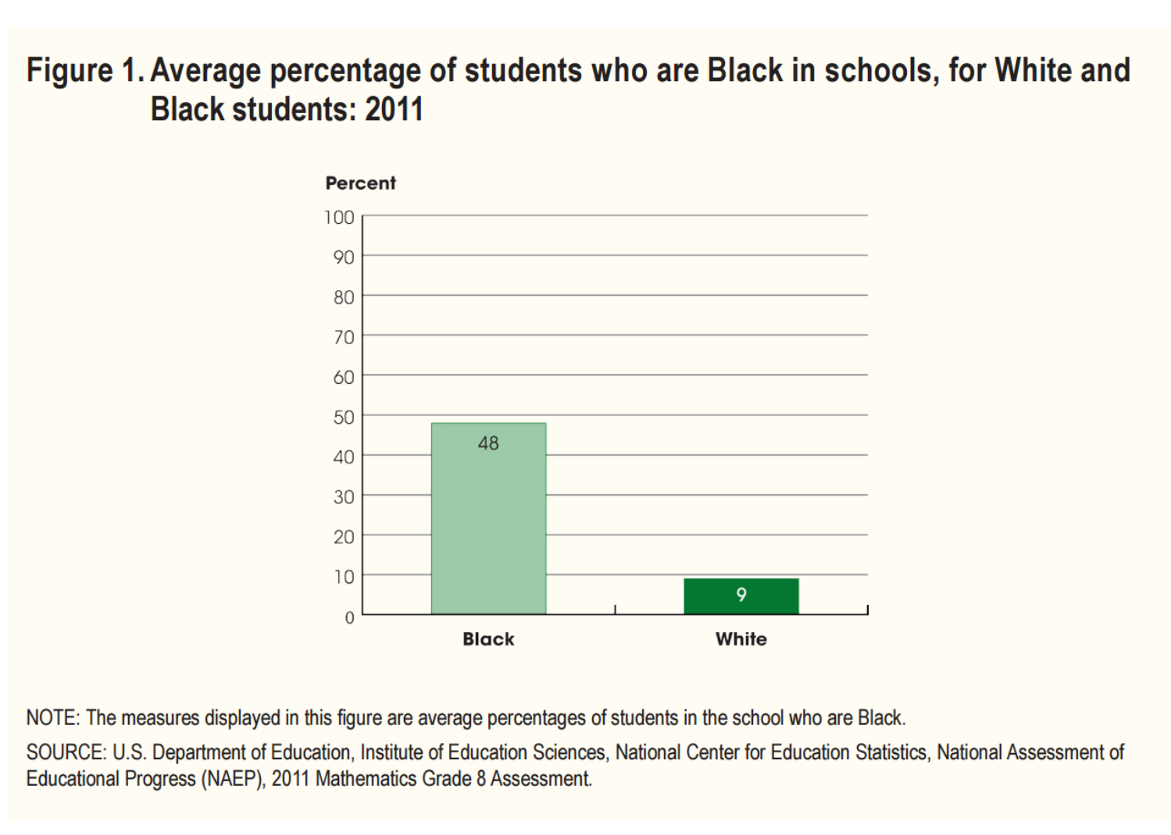

Slide 46
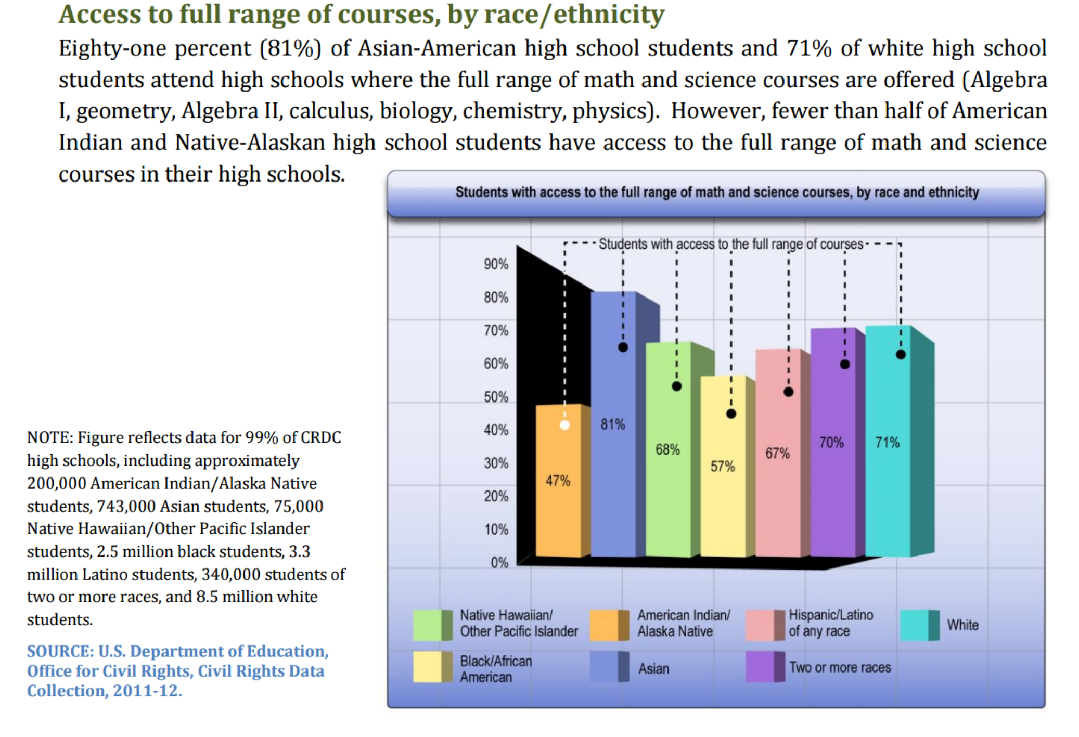

Slide 47
SUMMARY
Disadvantaged students are “behind” even before school starts … and they have fewer opportunities going forward in school.

Slide 48
RECURRING QUESTIONS
What are the goals of education?
Who gets to define and prioritize those goals?
How do some goals conflict with others?
Can improving education and schools—through policy or practice—really accomplish all of those goals?
Do schools and education mainly reproduce inequality from generation to generation? Or, are they mainly a vehicle for overcoming it?
Does engaged community service in education-related organizations solve underlying problems, or merely alleviate their symptoms?

Slide 49
DISCUSSION
Where do sex, race, and SES differences in educational opportunities come from?
Do schools make them better or worse?

Slide 50
Results from Earlier Exercize

Slide 51
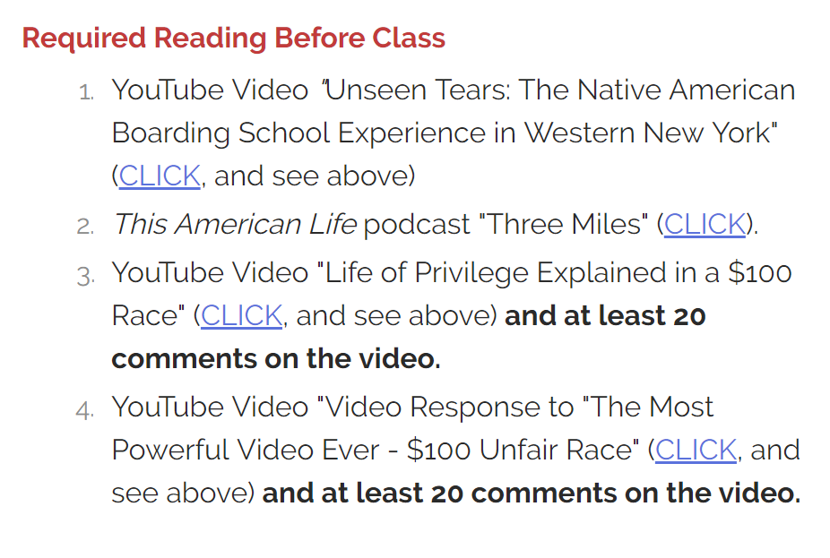
DISCUSSION
What do these
materials
contribute
to this
discussion?

