Slide 2
Inequality

Slide 4
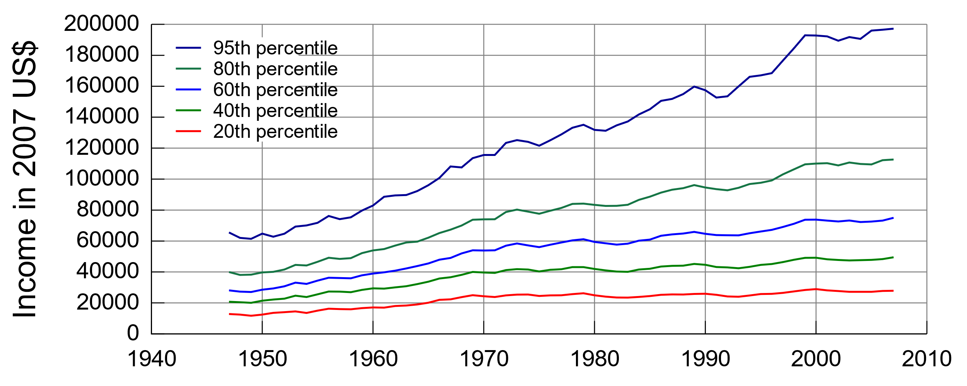
Souce: "Table F-1. Income Limits for Each Fifth and Top 5 Percent of Families (All Races): 1947 to 2007", U.S. Census Bureau, Current Population Survey, Annual Social and Economic Supplements, as found at https://www.census.gov/hhes/www/income/histinc/f01AR.html

Slide 5
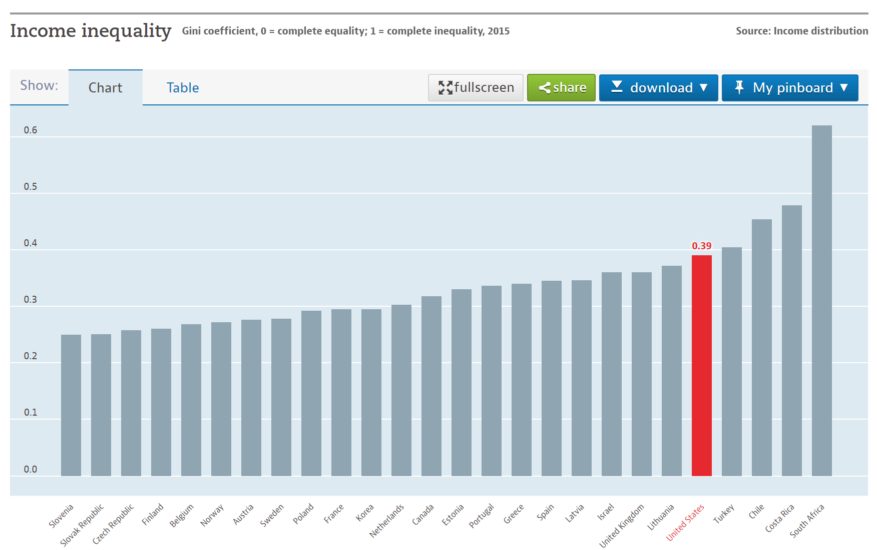

Slide 6
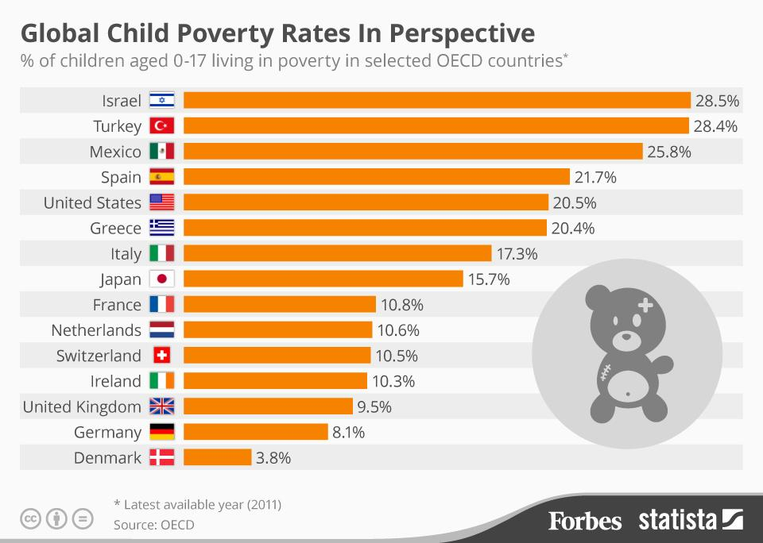

Slide 7
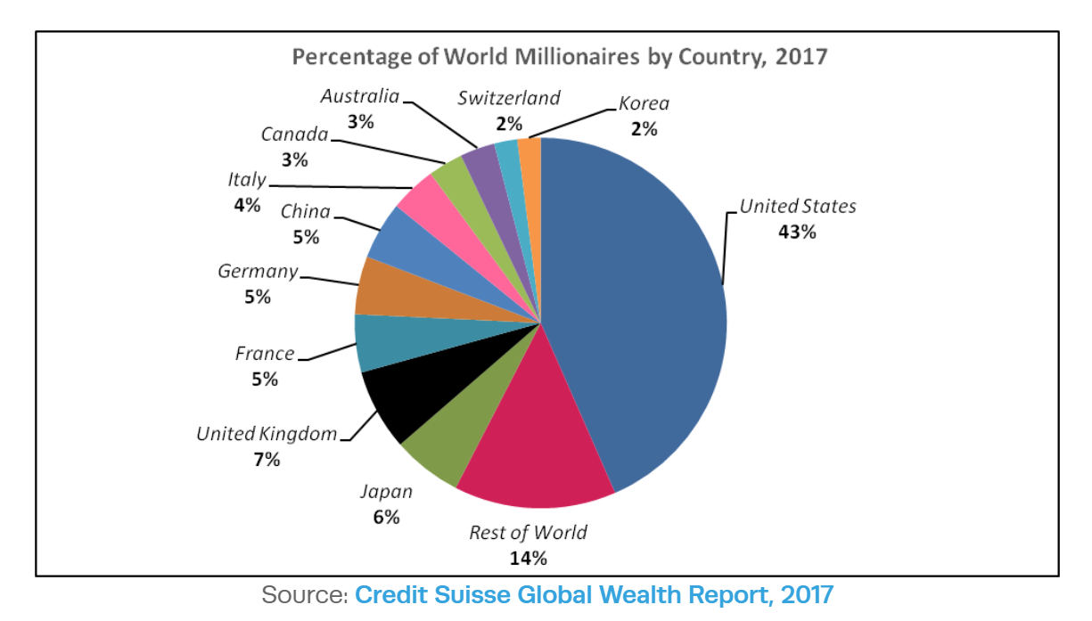

Slide 8
Summary
America is unequal, more unequal than most other countries, and inequality has grown over time

Slide 9
Summary
America is unequal, more unequal than most other countries, and inequality has grown over time
Is this OK? Fair?

Slide 10
Inequality of Outcomes
vs.
Inequality of Opportunities

Slide 11
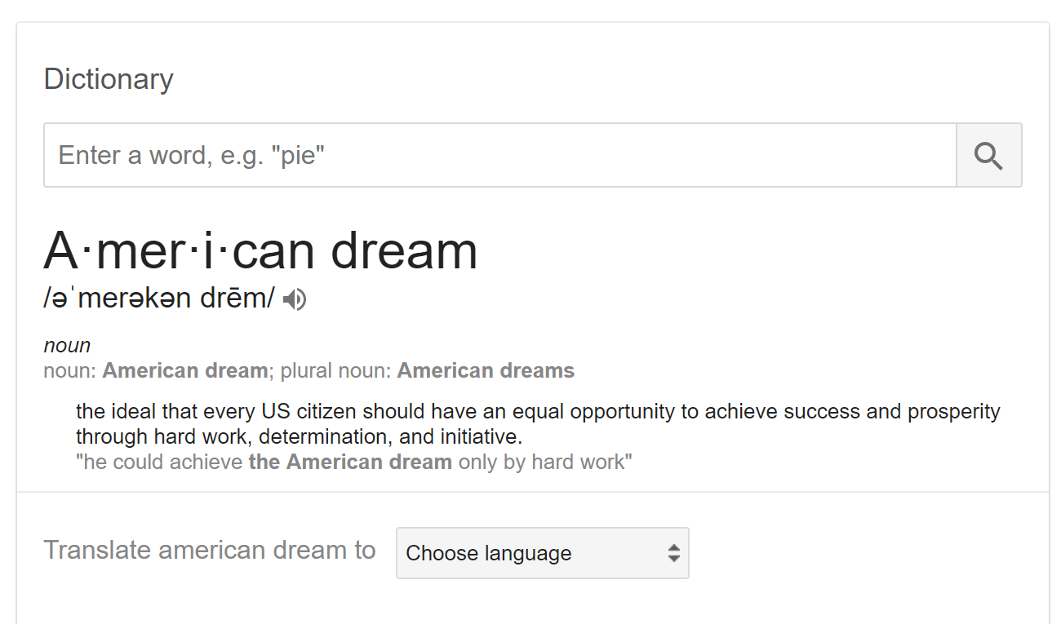
The American Dream

Slide 12
The American Dream?

Slide 13
Social and Economic Mobility

Slide 14
Intergenerational EDUCATION Mobility
BA+
Some
College
HS
<H.S.
Parent =
Source: U.S. General Social Survey, adapted from Hout and Janus 2008. Figure shows education of highest educated parent and
Of children age 25-64 born n the 1990s and interviewed by 2006.

Slide 15
Intergenerational OCCUPATIONAL Mobility
Unskilled
S.E.
T/Skilled
Farm
Lower
Upper Prof.
Parent =
Source: U.S. General Social Survey, adapted from Beller and Hout 2006. Figure shows occupations of fathers and sons interviewed
Between 1988 and 2004.

Slide 16
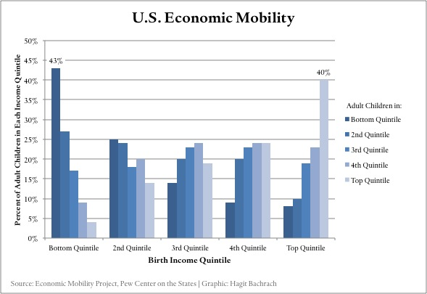
Intergenerational INCOME Mobility

Slide 17
Trends Over Time

Slide 18
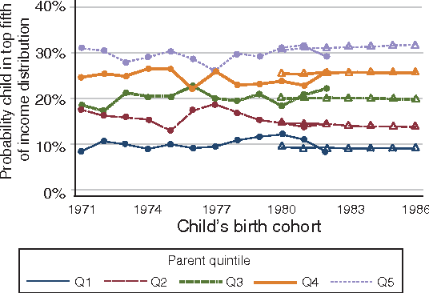
Probability of Being in the Top 20% of Income,
by Parent’s Income Quintile and Year of Birth
Source: Chetty, R., Hendren, N., Kline, P., Saez, E., & Turner, N. (2014). Is the United States still a land of opportunity? Recent trends in intergenerational mobility. American Economic Review, 104(5), 141-47.

Slide 19
Cross-National Comparisons

Slide 20
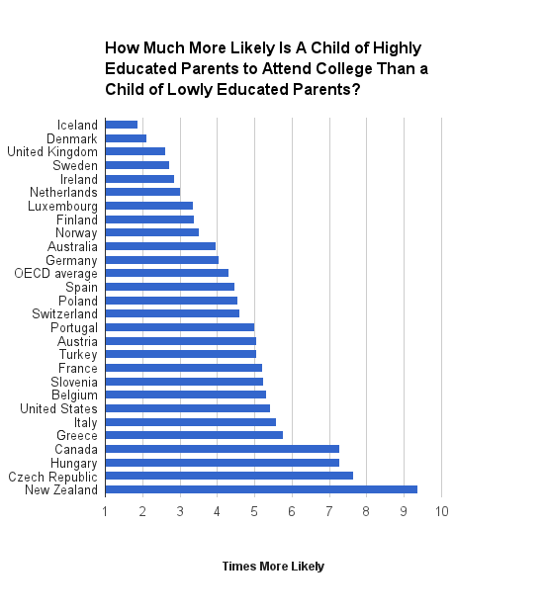
http://www.demos.org/blog/12/28/14/where-educational-mobility-highest

Slide 21
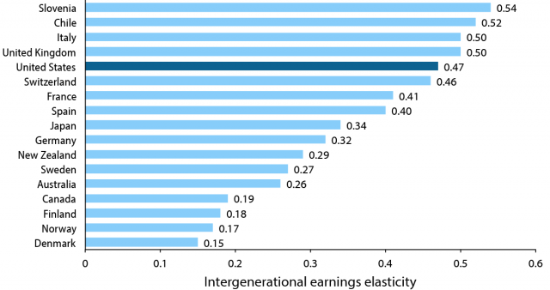
http://www.demos.org/blog/12/28/14/where-educational-mobility-highest

Slide 22
Summary
There is both mobility & immobility in America
America has somewhat less mobility than many other countries
Mobility rates have mainly held steady over time

Slide 23
The American Dream?

Slide 24
The American Dream?
What are the implications if we assume that the American Dream is real for everyone today (although maybe it wasn’t in the past)?
How do we explain the figures above?
Notes:
- Obvious critique: Slavery, segregation, etc. But let's just say that's a historical legacy that's been overcome?
- If we assume there is equal opportunity, then it logically follows that poor people (1) don't want to do better or (2) just aren't able to do better. See all racist, sexist, or classist stereotypes.

Slide 25
Where Could We Intervene?

Slide 26
Very Basic Model of Socioeconomic Mobility
Parents’
Social &
Economic
Position
Child’s
Social &
Economic
Position
Child’s
Education

Slide 27
Where Can We Disrupt Social Reproduction?
Parents’
Social &
Economic
Position
Child’s
Social &
Economic
Position
Child’s
Education

Slide 28
Inequality in Education Outcomes
Parents’
Social &
Economic
Position
Child’s
Social &
Economic
Position
Child’s
Education

Slide 29
Inequality in the Effects of Education
Parents’
Social &
Economic
Position
Child’s
Social &
Economic
Position
Child’s
Education

Slide 30
The Role of Education in Social Mobility

Slide 31
Intergenerational INCOME Mobility, by EDUCATION
Average
FB
Parent $ =
Source: U.S. General Social Survey, 1972-2016.

Slide 32
Intergenerational INCOME Mobility, by EDUCATION
FA
Average
FB
Parent $ =
Kid’s Education = HS or Less BA or More
Source: U.S. General Social Survey, 1972-2016.

Slide 33
Summary
Education can be a pathway out of disadvantaged social and economic origins

Slide 34
Summary
Education can be a pathway out of disadvantaged social and economic origins
…but it isn’t a guarantee

Slide 35
Inequality in Education Outcomes
Parents’
Social &
Economic
Position
Child’s
Social &
Economic
Position
Child’s
Education

Slide 36
Intervening in Inequalities in
Educational Outcomes

Slide 37
SOURCE: U.S. Department of Education, National Center for Education Statistics, Early Childhood Longitudinal Study, Birth Cohort (ECLS-B), Longitudinal 9-Month–Kindergarten 2007 Restricted-Use Data File.

Slide 38
SOURCE: U.S. Department of Education, National Center for Education Statistics, Early Childhood Longitudinal Study, Birth Cohort (ECLS-B), Longitudinal 9-Month–Kindergarten 2007 Restricted-Use Data File.

Slide 39
SOURCE: U.S. Department of Education, National Center for Education Statistics, Early Childhood Longitudinal Study, Birth Cohort (ECLS-B), Longitudinal 9-Month–Kindergarten 2007 Restricted-Use Data File.

Slide 40
Source: National Center for Education Statistics. 2014. Digest of Education Statistics: 2014. Washington, DC: US Department of Education. (Table 202.60)

Slide 41
Intervening in Early Childhood Education

Slide 42
Intervening in Early Childhood Education
…and likewise for other places in which we might intervene in educational inequalities

Slide 43
So Far, We’ve Talked About This…
Parents’
Social &
Economic
Position
Child’s
Social &
Economic
Position
Child’s
Education

Slide 44
…but What About This?
Parents’
Social &
Economic
Position
Child’s
Social &
Economic
Position
Child’s
Education

Slide 45
Discussion
What are the roles of schools and families in creating inequalities in educational outcomes?

Slide 46
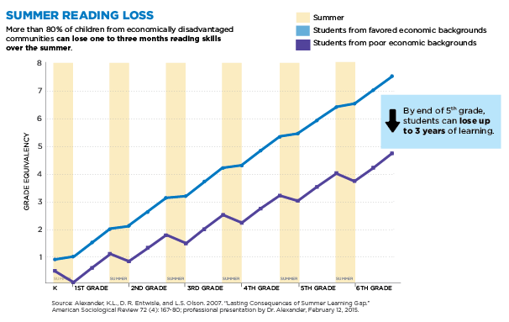

Slide 47
Should We Intervene in Schools? Or Families?
Parents’
Social &
Economic
Position
Child’s
Social &
Economic
Position
Child’s
Education

Slide 48
Should We Be Depressed? Cynical?

Slide 49
Langston Hughes
Let America Be America Again

Slide 50
The American Dream?

Slide 51
The American Dream?
Not yet

Slide 52
The American Dream?
“O, let America be America again—
The land that never has been yet—
And yet must be—the land where every man is free.”
Langston Hughes
Let America Be America Again

Slide 53
The American Dream?
“O, let America be America again—
The land that never has been yet—
And yet must be—the land where every man is free.”
Langston Hughes
Let America Be America Again
person

