Slide 1
Student Behavior, Violence, and Discipline
Brandon Brooks
Binyam Mehari
Keaon Dousti

Slide 2
Student Behavior, Violence, and Discipline & CEL

Slide 3
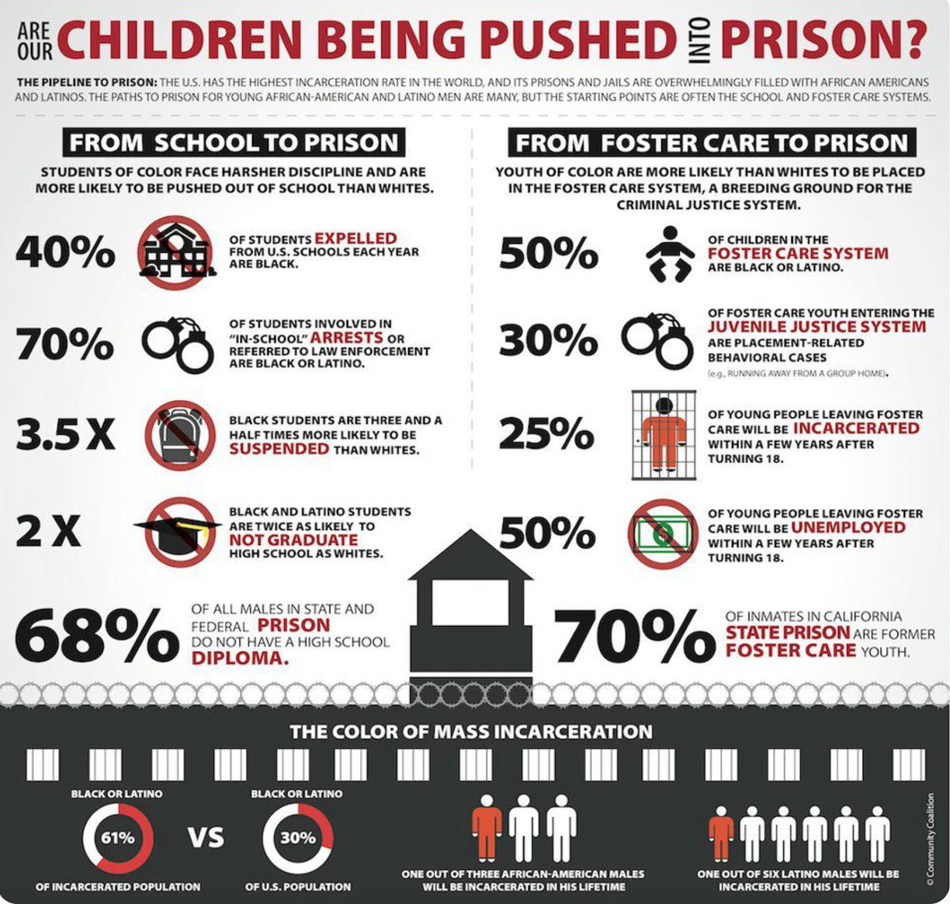
The Issues and its Importance
School-to-Prison Pipeline
Set of policies and procedures which funnel students from school into prison.
Teacher/Student Safety
Critical to keep students, teachers, and faculty to promote a healthy and safe environment.

Slide 4
History
Moved from physical punishment in 1900s (hitting students with rulers) to removing students from classroom.
The US Supreme Court has never ruled on corporal punishment. It is left to the states.
19 states still allow corporal punishment.
B.F. Skinner’s 20th century philosophy that human behavior determined by consequences and bad behavior is punished.
Time outs, detentions, suspensions, etc.
1 in 7, K-12 students in the United States suspended in 2010-2011
Recent uptick in last 20 years of more discipline and security
Why is this?
Notes:
Alabama, Arizona, Arkansas, Colorado, Florida, Georgia, Idaho, Indiana, Kansas, Kentucky, Louisiana, Mississippi, Missouri, North Carolina, Oklahoma, South Carolina, Tennessee, Texas and Wyoming

Slide 5
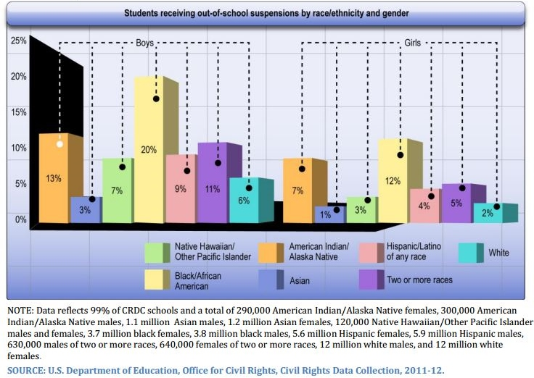
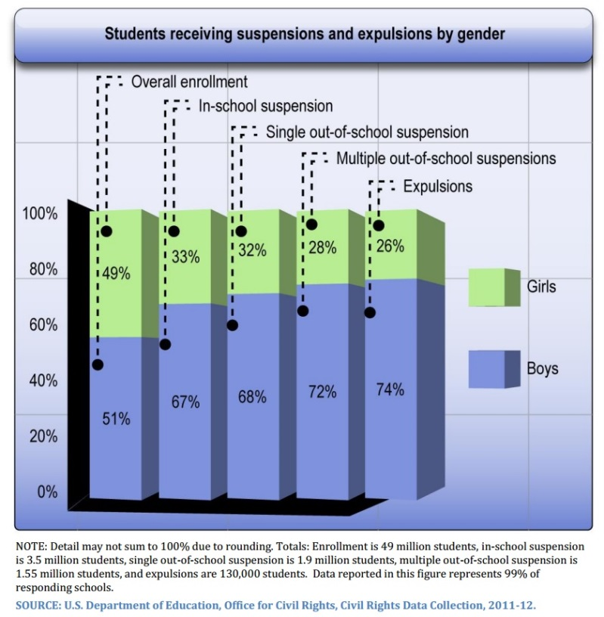
Gender/Race Dynamics

Slide 6
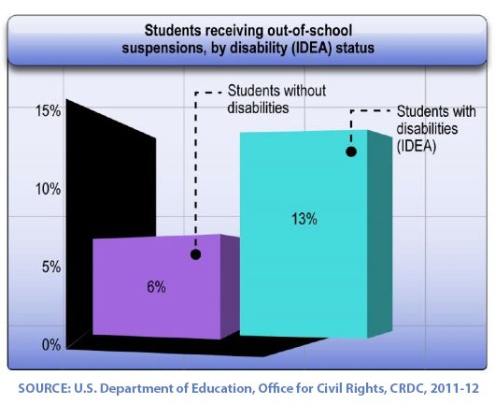
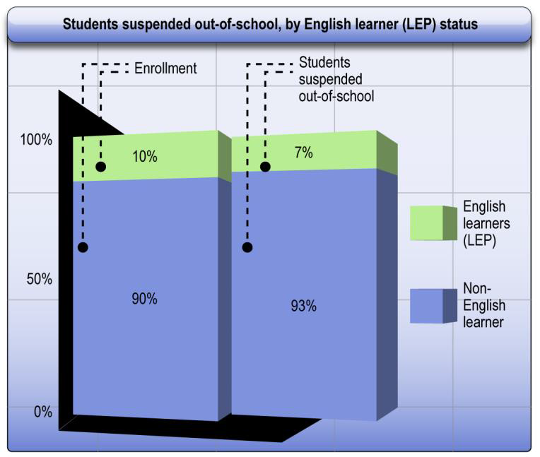
Disabilities and English-Speaking Learners

Slide 7
Internationally
Australia: Very diverse plan of correcting the student's behavior; setting up a student development plan, with the incorporation of family, teachers, even a social worker
France: Based on the amount of action or disruptive behavior; punishments can range from extra homework, to having teaching assistants known as vie scolaire to monitor the student’s behavior
United Kingdom: Similar in many ways the U.S. conducts behavior and discipline policy, however teachers are allowed to restain students and there are complaint procedures for parents to follow through on suspensions or exclusions.
South Africa: “Learner Discipline and School Management” on a leveled system on rating disciple based on actions to aid teachers and students on the best possible course of action.
Japan: In correspondence with the National Constitution, guaranteeing students the right to an education and the classroom; Most teachers can’t discipline students for improper or disruptive behavior.

Slide 8
Notes:
Steve Speaks

Slide 9
Proposed Solutions in Minnesota

Slide 10
Proposed Solutions in Minnesota
“Teacher Protection Act” Proposed by Senator Dave Brown, SF 2323
(a) A school board must expel a student who assaults a teacher. The duration of the expulsion is at the discretion of the school board. "Assault" has the meaning given in section 128C.08, subdivision 1.
(b) A school board must expel a student who assaults a teacher. The duration of the
expulsion is at the discretion of the school board. "Assault" has the meaning given in
section 128C.08, subdivision 1.
128C.08 ASSAULTING A SPORTS OFFICIAL PROHIBITED.
Subdivision 1.
"Assault" is (1) an act done with intent to cause fear in another of immediate bodily harm or death, or (2) the infliction of or attempt to inflict bodily harm upon another.

Slide 11
Proposed Solutions in Minnesota

Slide 12
Proposed Solutions in Minnesota
“Student Inclusion & Engagement Act” Proposed by Senator Sandy Pappas; SF 2898
(a) No public school shall deny due process or equal protection of the law to any
public school pupil involved in a dismissal proceeding which may result in suspension,
exclusion, or expulsion.
(b) School officials must use nonexclusionary disciplinary policies and practices,
including positive behavior interventions and support, and attempt to provide alternatives
under section 121A.575, clause (1) or (2), among other interventions and strategies, before
beginning dismissal proceedings and, to the extent practicable, must limit pupil dismissals,
consistent with section 121A.45, subdivision 1.

Slide 13
What Do You Think?
Break into groups of seven (there will be groups with more). Your groups represent different school boards. We will present you with 5 priorities and their definitions.
Your task is to fund 3 of these 5 priorities as they relate to discipline in education.
Address the 2 priorities you did not fund, and why.
Discuss with your group members, then we will share as a group.

Slide 14
What Do You Think?
COUNSELORS/SWPBIS
SCHOOL RESOURCE OFFICERS
CULTURAL AWARENESS TRAINING
AFTER SCHOOL ENRICHMENT PROGRAMS
SECURITY GUARDS

Slide 15
Worked Cited
School discipline and exclusions. (n.d.). Retrieved October 03, 2016, from https://www.gov.uk/school-discipline-exclusions
http://wced.school.za/documents/LearnerDiscipline/Learner_Discipline_and_School_Management.pdf
General Operation of French Schools. (n.d.). Retrieved October 03, 2016, from https://www.french-property.com/guides/france/public-services/school-education/operation/discipline-attendance/
Suspension and exclusion from school. (n.d.). Retrieved October 03, 2016, from https://www.sa.gov.au/topics/education-skills-and-learning/schools/school-life/behaviour-management-and-discipline/suspension-and-exclusion#title2
Discipline in schools is not a bad thing | The Japan Times. (n.d.). Retrieved October 03, 2016, from http://www.japantimes.co.jp/community/2010/08/31/voices/discipline-in-schools-is-not-a-bad-thing/#.V_Ltb48rKM8

