Slide 1


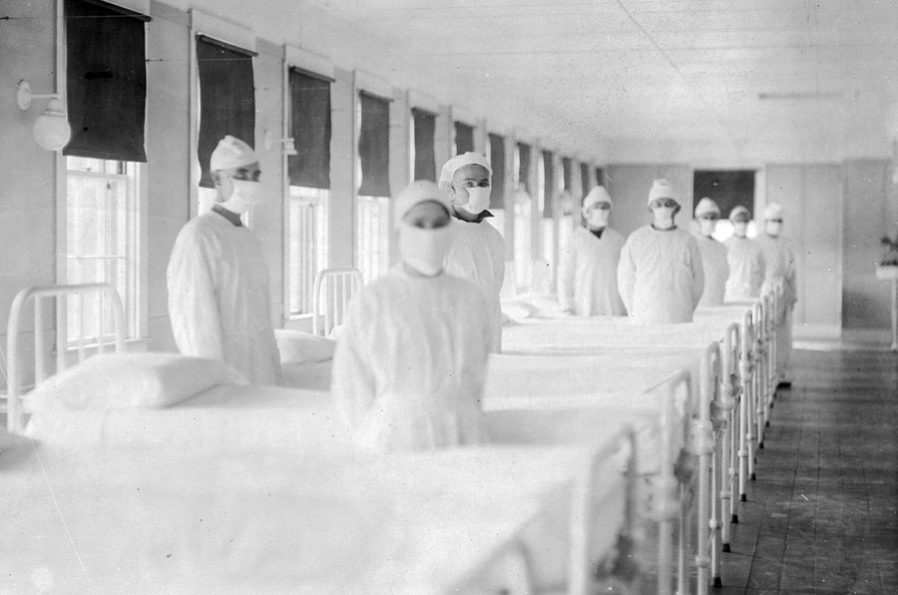
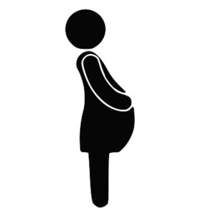


The Effect of In Utero Exposure to the 1918 Influenza Pandemic on Life
Expectancy in the United States
Elaine M. Hernandez (Indiana University), Jonas Helgertz (Lund University & University of Minnesota), John Robert Warren (University of Minnesota),
Florencia Torche (Stanford University), Claire Margerison (Michigan State University), Elizabeth M. Anderson (Indiana University)
Research Questions
Data Linkage
need
Results
Does in utero exposure to the 1918 influenza pandemic decrease (1) adult educational attainment and (2) life expectancy?
Exposure to the pandemic is linked to increased rates of physical disability, cardiovascular problems, cancer, and metabolic disorders. Previous research has also found that in utero exposure to the 1918 influenza pandemic led to lower educational attainment.
Yet, we do not know whether in utero exposure has an effect on overall life expectancy.
1920 U.S. Census Data
(12.7 million males)
1940 U.S. Census Data
(4.4 million males)
Social Security Death Master File
(1.8 million males)
In utero exposure did not predict lower levels of educational attainment or a shorter life expectancy, supporting the idea that the weakest fetuses exposed in utero died leaving a healthier cohort (i.e., culled cohort).
Individual’s race & parental occupational attainment
Individual’s educational attainment, occupation & income
Individual’s time of death & exact date of birth
Analytic Approach
Mortality selection following in utero exposure to 1918 influenza pandemic.
We measure exposure as above average deaths/mo. due to influenza/pneumonia compared to mean mortality during 1910-1915.
This approach enables an analysis of city-level differences in timing, duration, and intensity for 30 cities in 24 states.
We estimate sibling fixed-effects models comparing (1) educational attainment and (2) age at death between exposed respondents and unexposed siblings.
Source: U.S. Navy
Sample of individuals in the Social Security Death Master File are “more robust.”
Results
Figure 1. Excess All-Cause Mortality by State, 1918-1919
Table 1: Sibling Fixed Effect Model Comparing Age at Death for Respondent Exposed In Utero and Unexposed Sibling
 | Model A |  |  |  | Model B
 | β (SE) |  |  |  | β (SE)
Trimester Exposure
First Trimester | -0.018 |  | (0.506) |  | --
Second Trimester | 0.518 |  | (0.424) |  | --
Third Trimester | -0.573 | * | (0.320) |  | --
Trimester & City Exposure
First Trimester in a "Medium Exposure" City | -- |  |  |  | -0.323 |  | (0.569)
First Trimester in a "Low Exposure" City | -- |  |  |  | 0.216 |  | (0.684)
First Trimester in a "High Exposure" City | -- |  |  |  | 0.269 |  | (0.744)
Second Trimester in a "Medium Exposure" City | -- |  |  |  | 0.438 |  | (0.504)
Second Trimester in a "Low Exposure" City | -- |  |  |  | 0.377 |  | (0.691)
Second Trimester in a "High Exposure" City | -- |  |  |  | 0.848 |  | (0.702)
Third Trimester in a "Medium Exposure" City | -- |  |  |  | -0.712 | * | (0.416)
Third Trimester in a "Low Exposure" City | -- |  |  |  | -1.06 | * | (0.602)
Third Trimester in a "High Exposure" City | -- |  |  |  | 0.358 |  | (0.585)
Own Educational Attainment Categorical
reference group less than 12 years
12 years | 1.117 | *** | (0.173) |  | 1.116 | *** | (0.173)
>12 years | 1.56 | *** | (0.246) |  | 1.568 | *** | (0.246)
Observations | 48,002 |  |  |  | 48,002
R² | 0.005 |  |  |  | 0.005
Number of families | 23,221 |  |  |  | 23,221
Robust standard errors in parentheses
*** p<0.01, ** p<0.05, * p<0.1
Note: Models control for race defined as black or white.
Future Steps
In future work we plan to (a) include females and (b) link to the 1920/1930 US Censuses to test whether in utero exposure to the 1918 pandemic increased rates of child mortality.
Conceptual Framework
Acknowledgements
Support was provided by the Minnesota Population Center, which receives core funding (P2CHD041023) from the Eunice Kennedy Shriver National Institute for Child Health and Human Development (NICHD).
Trimester (mo/yr) of infectious exposure in utero
Adult educational attainment
(~21-22 years old)
Life expectancy
(age at death)

